Slide 1


Challenges and opportunities for Forwarding Companies in the new normal period and adjusting their business development strategies
Ho Chi Minh City, 09th Oct 2021
Mr. Teo Yak Long
General Director of SNG Logistics

Slide 2

Important!
A government established frameworks provided fully transparency between Exporter / Importer , Ports , Customs , Banks and related operating fields.
Reducing direct human interaction and ensure normal operations for shipping and logistics companies.

Slide 3


The degree of transparency is important whether to achieve 50 % or 100 % success
SNP is in good position to suggest related authorities to change the system to achieve 100% target
e-B/L , e-D/O and e-customs

Slide 4

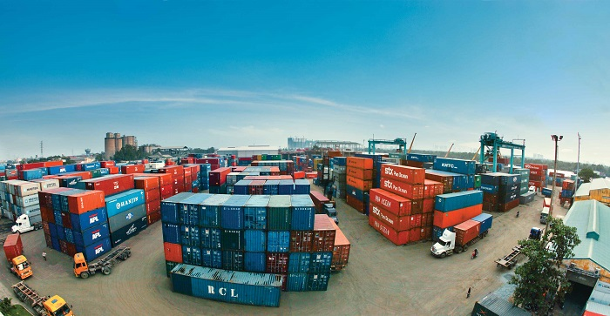

Customs still requires hard-copy document submission in additional to the soft copies
Recommendation
Government should review this matter to improve and simplify procedures further
Customers require the hard copy B/L for payments

Slide 5

Company Investment
IT capabilities
Staff training
Huge benefits to the nation business can go on as usual without distraction

Slide 6
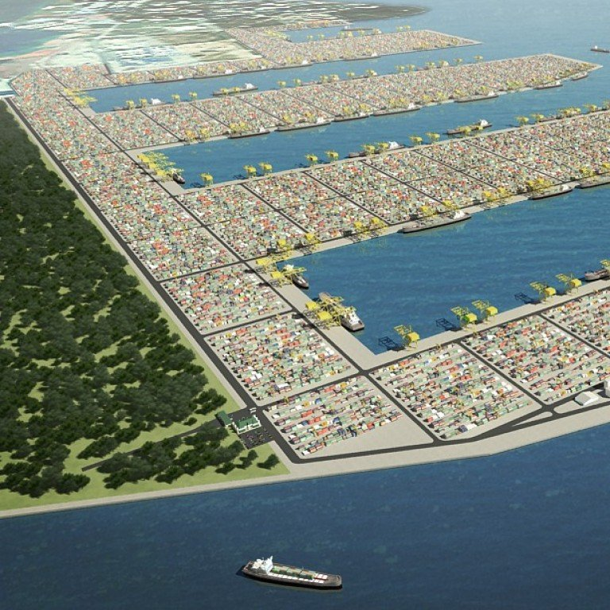
Full automation in Port , CY and CFS operation
Example
Short term benefit
Medium term benefit
Tuas container terminal in Singapore
Lesser workers – easy interface with truckers
Cost saving

Slide 7
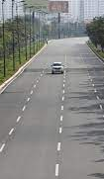
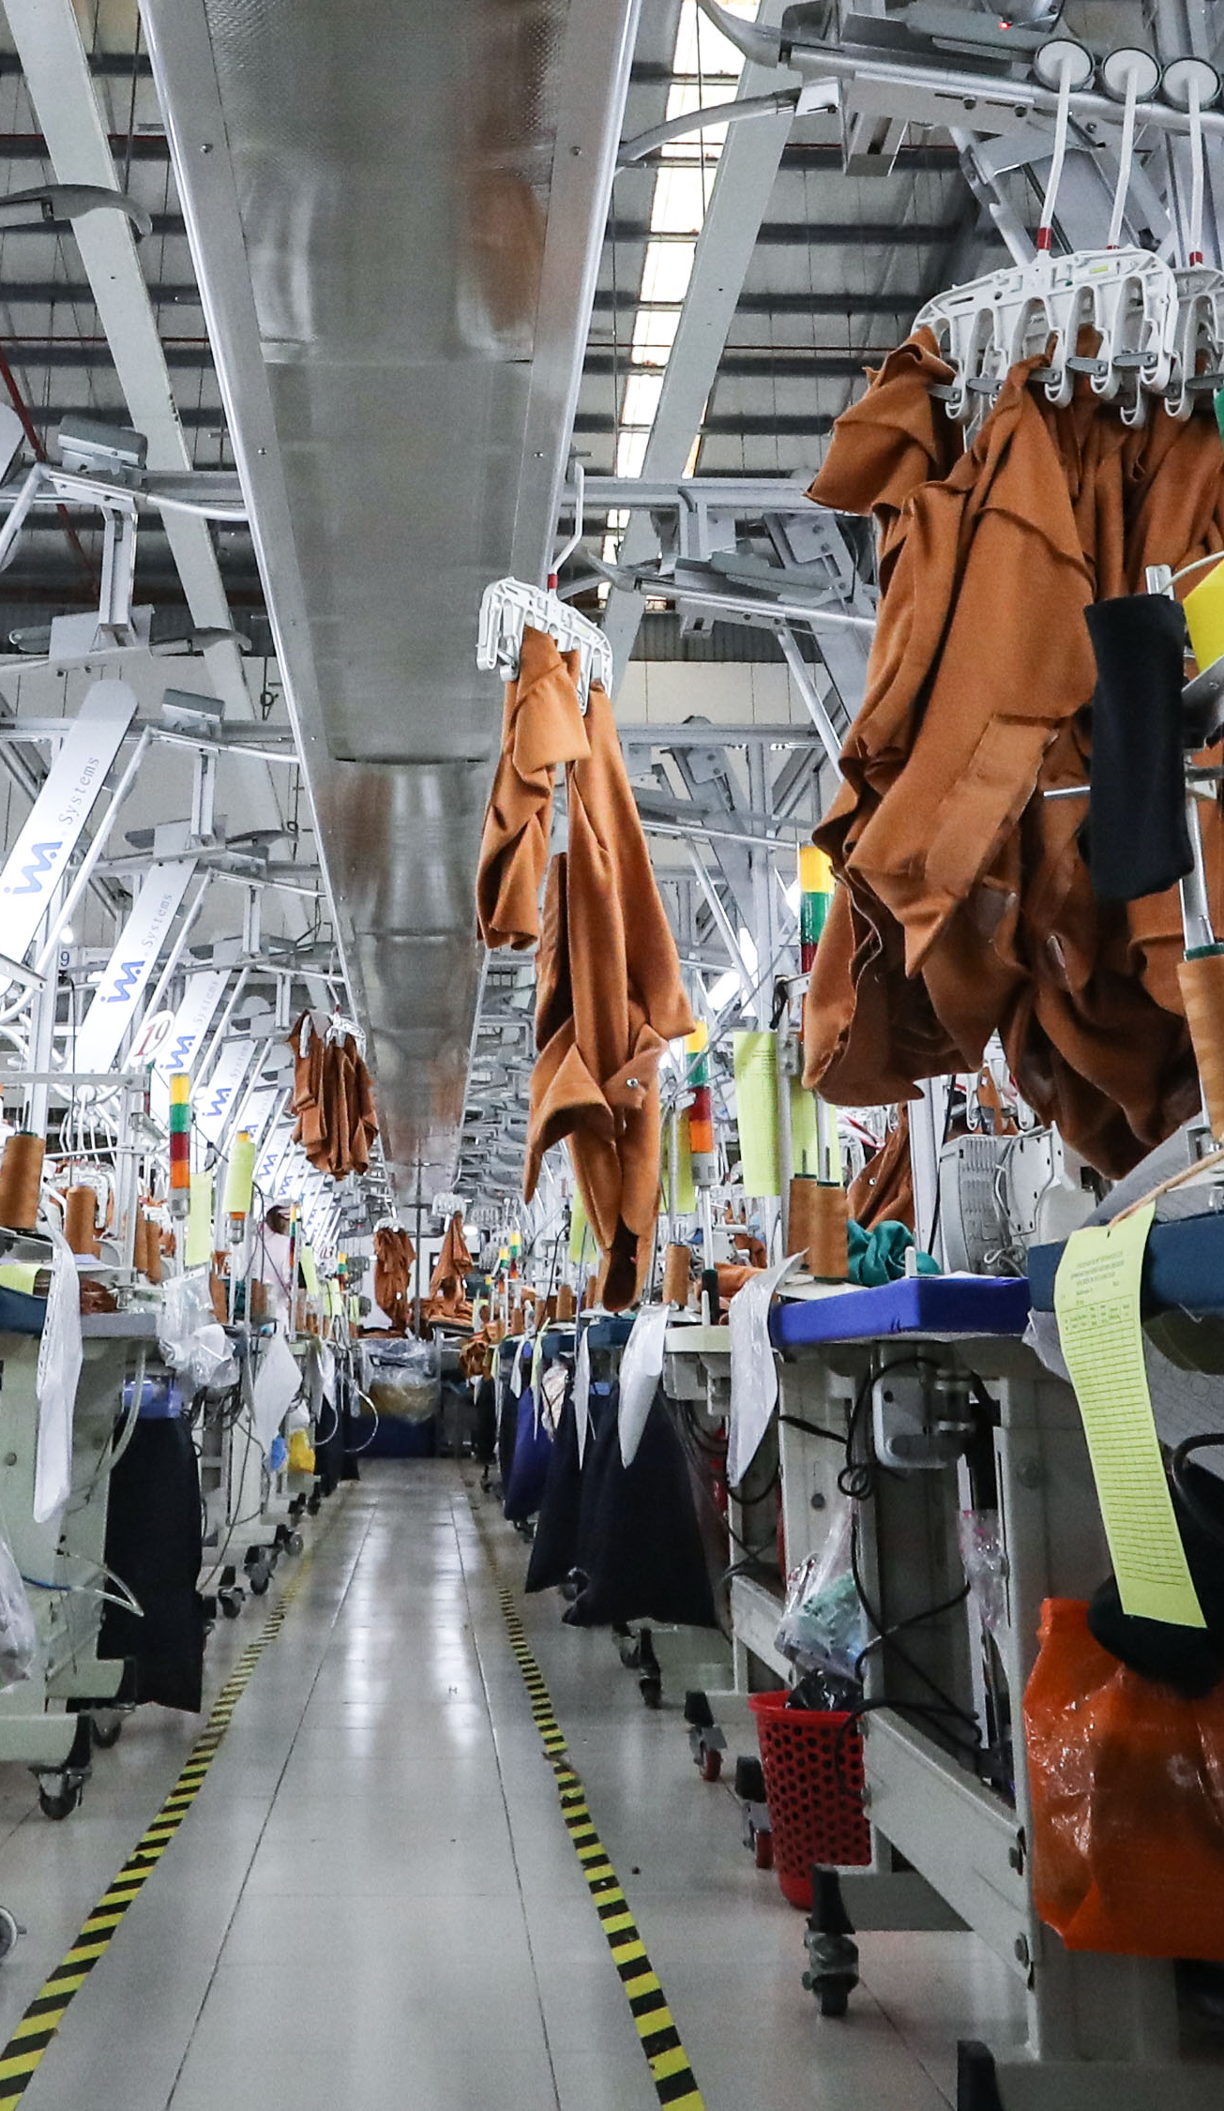
Current supply chain situation
Situation
Posibility
Prolong social distancing and lockdown measures affected factories’ activities
As a logistics co. it is necessary to extend its operation to neighboring countries to meet customers requirement .

Slide 8

2021
Marginal
Problem
Solution
Forecast
From 6.5 – 7% down to 3 – 3.5%
2.91% more than 2020
Lack of labour source
Government support

Slide 9
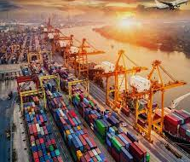
Thanks!

